Slide 1

GROUP D
DATA UNDERSTANDING & PREPARATION
ASHMA KHATUN, DAVID ARIZMENDI , JIE CHEN, LI LIN , MACRIN FRANCIS, QINGXUAN QI , YEE HERN KIMBERLY TAN

Slide 2
Project Overview
Based on records of previous 311 complaints, can we predict how long an incident will take to resolve?

Slide 3
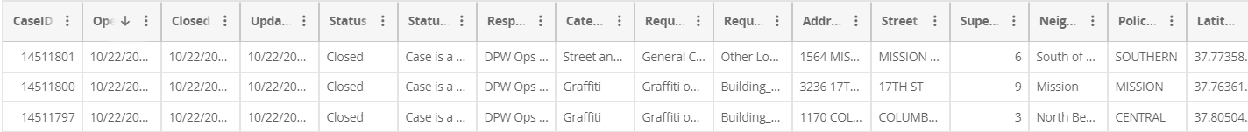
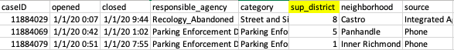
Data Selection
2020 311 Cases in San Francisco
Best dataset available for our purposes
Includes case opening and closing times
Original (20 columns)
Selected (8 columns)
Notes:
Maybe we should add the link to our dataset?

Slide 4
Data Joining
Registered Business Locations
Count of registered businesses
Datasets Joined Using Supervisor District
311 Incidents
City Facilities
Count of city facilities
Population
Main Dataset
Number of households
San Francisco Socio-Economic Profiles
Median Household Income
Poverty(%)
High School level education or less (%)
Secondary Datasets
# Vehicles Available
Data Extracted
Notes:
Shouldn’t it be “Joined On” or “Joined By” instead of “Joined Per”? I might be wrong but the “Per” sounds odd to me.

Slide 5


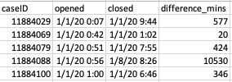
Data Cleaning
Duplicate cases:
Remove Duplicates
Remove N/As
Calculated and added target variable ‘difference_mins’
A
B
C
D
311 Cases | Original Dataset | Cleaned Dataset
Columns | 20 | 8 + 8 Joined
Rows | 512,628 | 452,165
Duplicates | 48,272 | 0
N/A | 12,191 | 0
SAME INCIDENT REPORTED WITH 4 COMPLAINTS

Slide 6
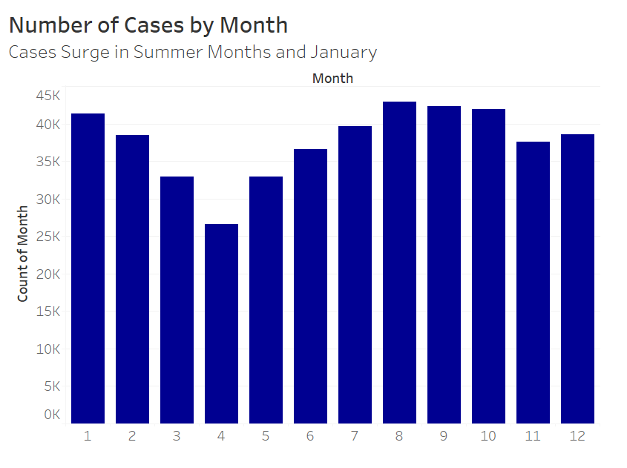
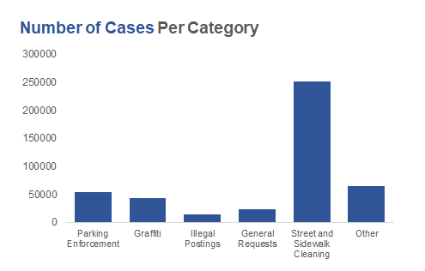
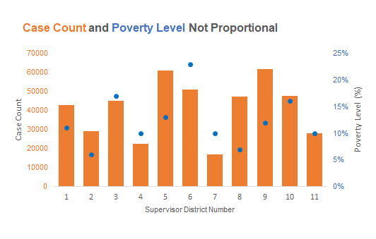
Data Exploration
Street and Sidewalk Cleaning cases are the majority
Cases increase from April to August:
2 peaks in August and January
No visible relationship between
case count and poverty level

Slide 7
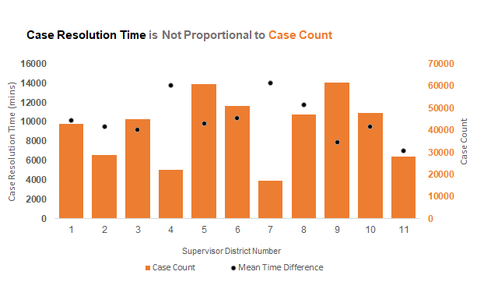
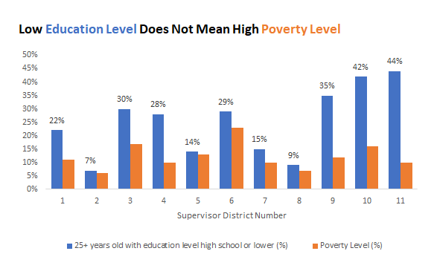
Data Exploration
No visible relationships between education level and poverty level, case resolution time and case count
Ran a correlation matrix:
No notable strong correlations between features

Slide 8

Q & A
THANK YOU!

